Slide 1
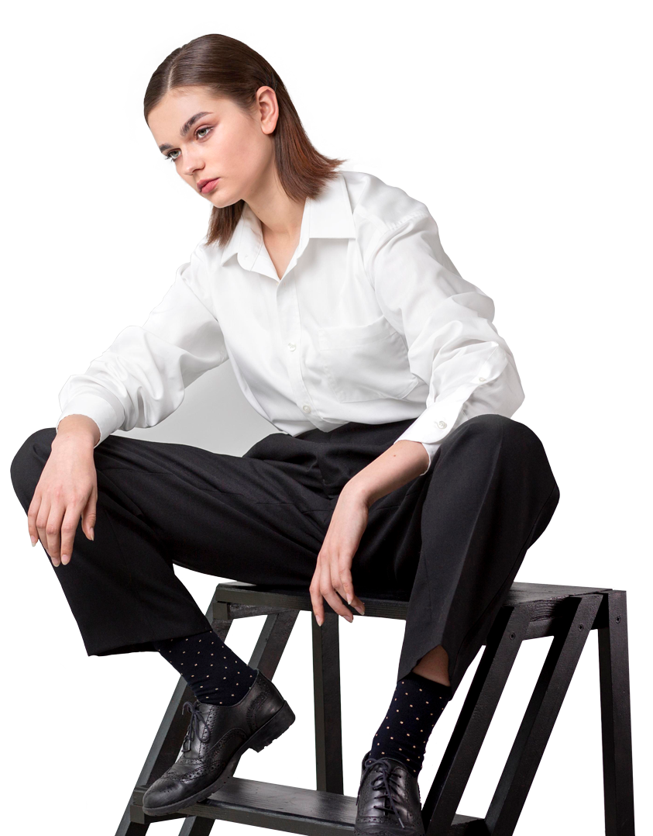
CURIO -Fashion & Style Assistant
A Minor Project
By :Shraddha Tiwari
Roll No.:20
College: DUIAS and DSIM&C

Slide 2
Style is a way to say who you are without having to speak.
”
—RACHEL ZOE

Slide 3
OBJECTIVE
WHY CURIO
Fashion is one of the most dynamic and rapidly evolving industries, with trends changing frequently and consumer preferences becoming increasingly personalized. With the advent of digital platforms, the way people discover, evaluate, and purchase fashion products has shifted significantly from physical stores to online mediums. While e-commerce platforms provide extensive catalogs of products, they often lack personalization and interactivity, leaving users overwhelmed and unsure about what suits their style, body type, or occasion.

Slide 4
MODULES
01
02
03
VISITOR
USER
ADMIN

Slide 5
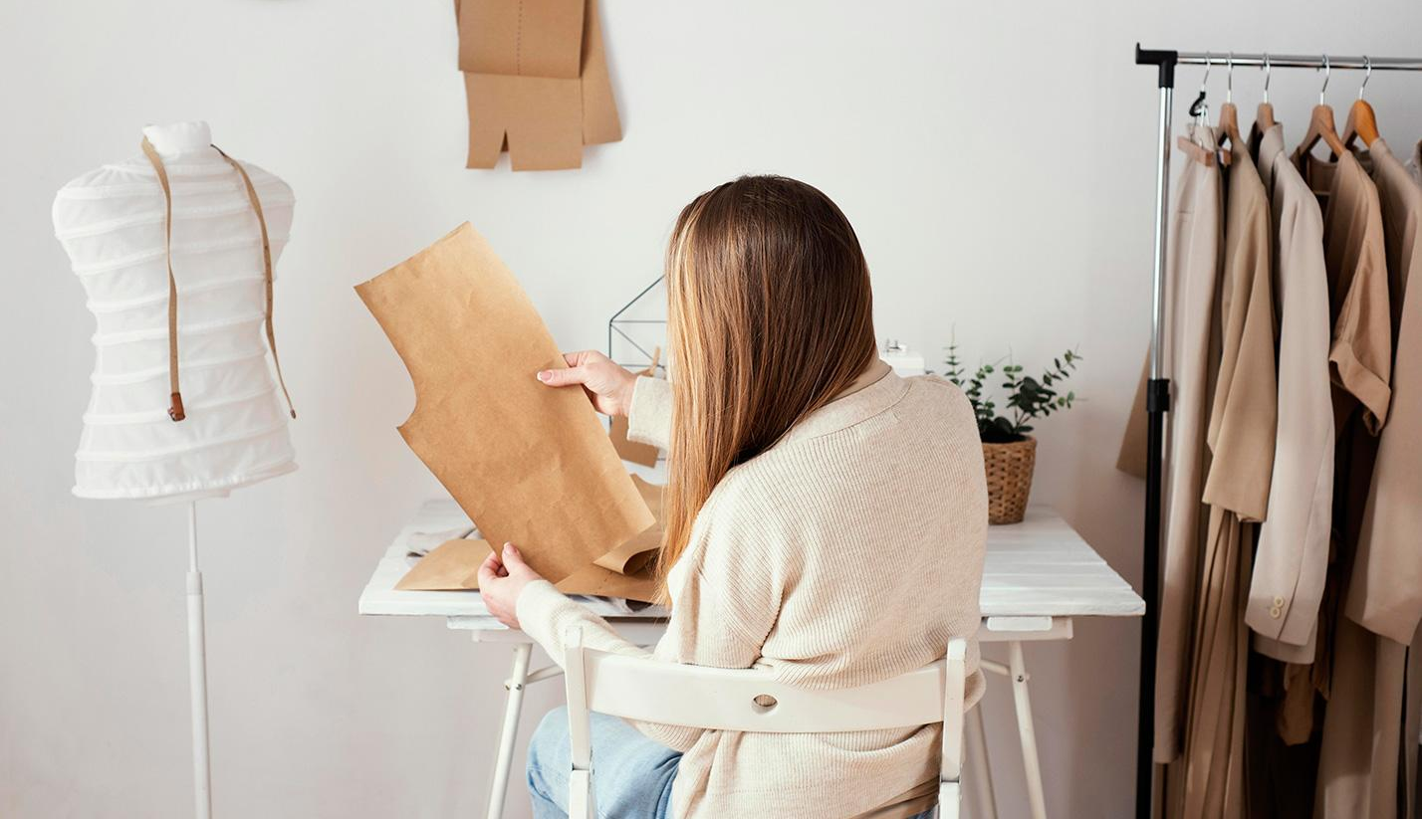
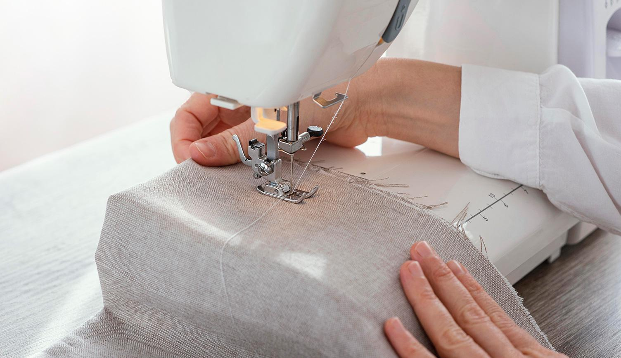
VISITOR
Has access to the landing page.
Can come across different sections like style, analysis, recommendation.
Can navigate to them via both navigation bar and footer.
Can obtain information from different sections like styles , analysis and recommendation.
Can send some query to the admin.
Can register into the system.
Needs to verify the email.
Has the facility to login

Slide 6
ADMIN
ACCESS
Has all the privilages combiningly together of both admin and user in single system.
MANAGE
Can manage / update / delete / insert new or existing information visible to the user
Privilages
HANDLE
Can generate reports , has dashboard and can edit self information.

Slide 7
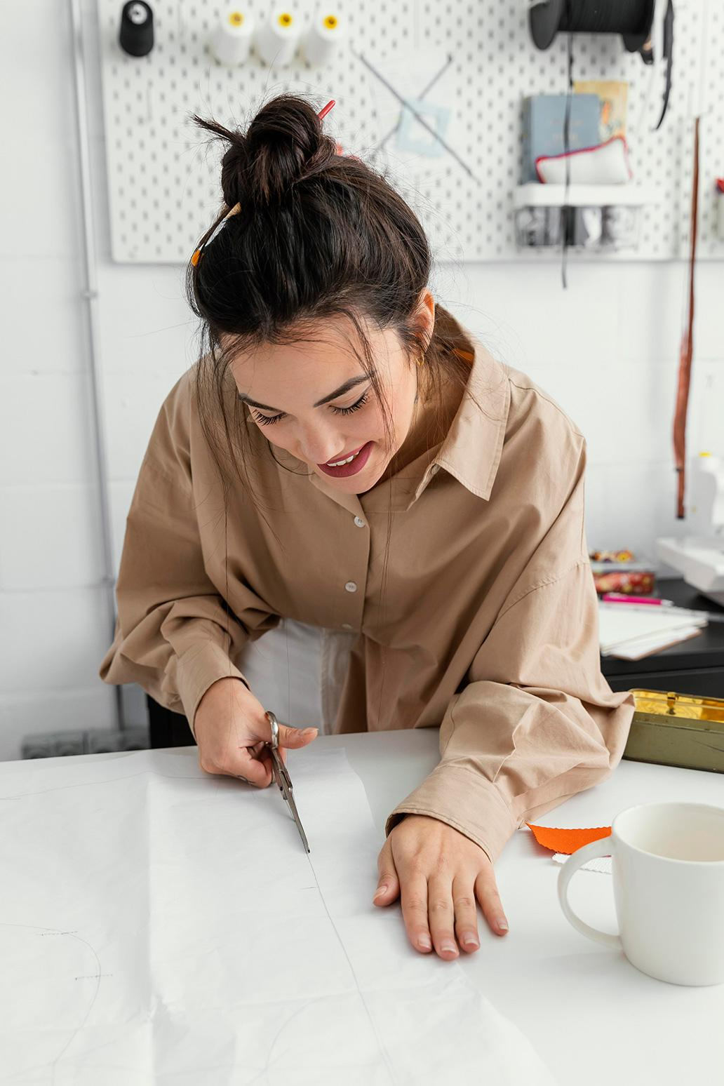
USER
User can enter into the system using login credentials.
Has all the functionalities of the visitor in addition to logout if wished.
Can update their own profile including password.
Can calculate for themselves like face shape, body type and height & build by giving the demanded input.
Has a profile page to view self data.

Slide 8
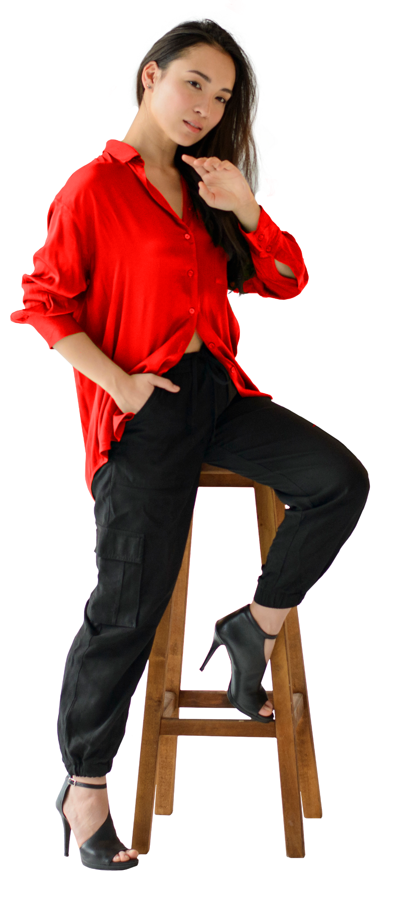
DFD Data Flow Diagram

Slide 9
Context
Level
Diagram

Slide 10
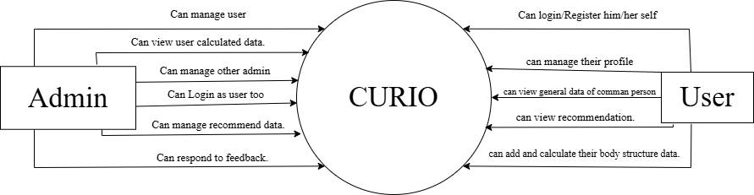

Slide 11
1st
Level
Diagram

Slide 12
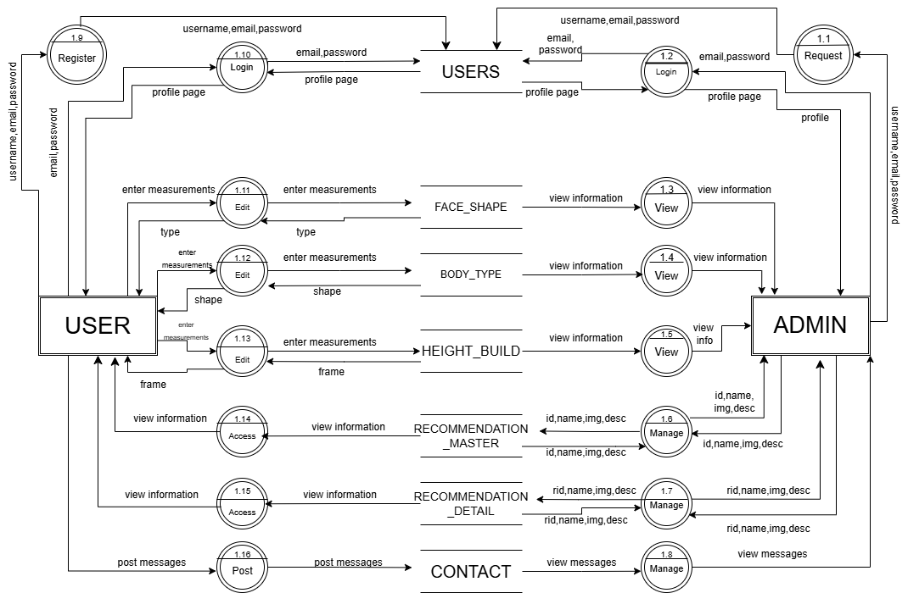

Slide 13
2nd
Level
Diagram

Slide 14
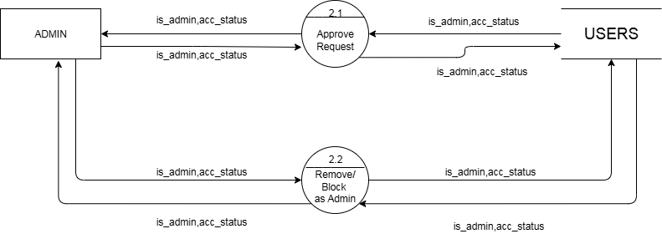

Slide 15
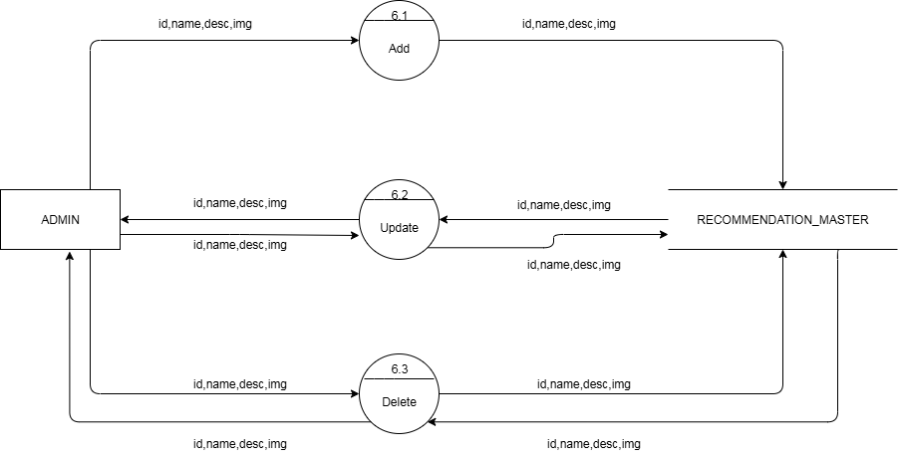

Slide 16
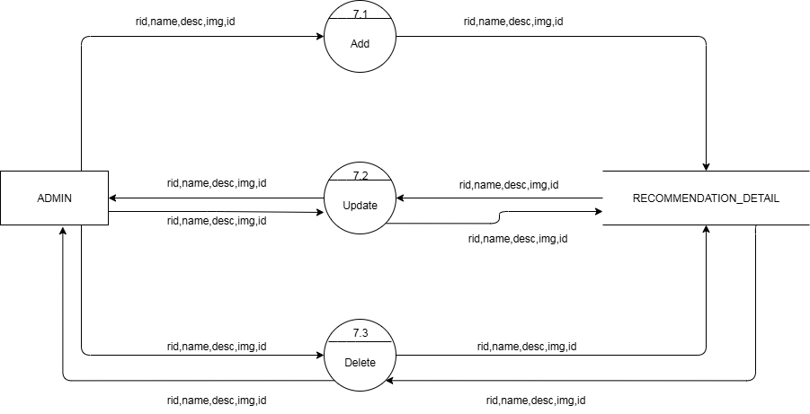

Slide 17
ERD Diagram

Slide 18
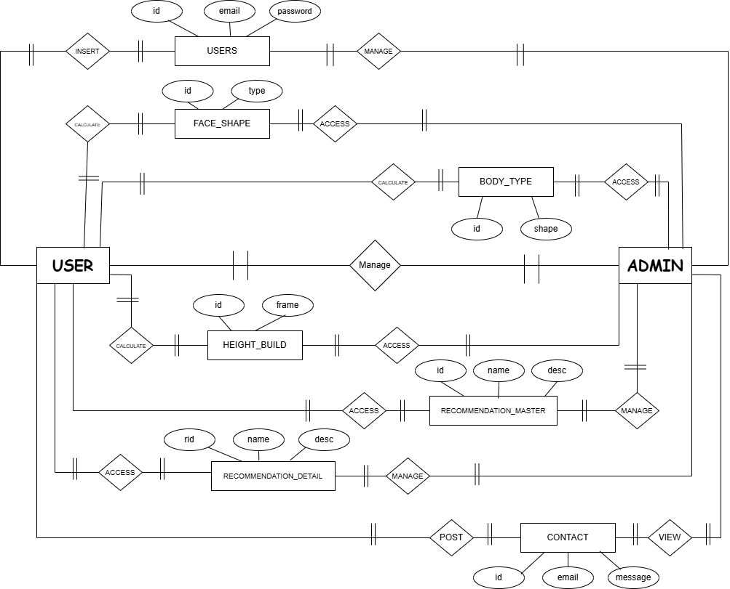

Slide 19
DATA DICTIONARY
The detailed description of all the entire collection created in the MongoDb.

Slide 20
Users
Sr | Field Name | Data Type | Constraint | Default Value | Description
1 | _id | String | Primary Key | N/A | Unique identifier for the user
2 | fullname | String | Not Null | N/A | Full name of the user
3 | username | String | Not Null, Unique | N/A | Username of the user
4 | dob | Date | Not Null | N/A | Date of birth of the user
5 | gender | String | Not Null | N/A | Gender of the user
6 | email | String | Not Null, Unique | N/A | Email address of the user
7 | password | String | Not Null | N/A | Password for user authentication
8 | is_admin | Integer | Not Null | 0 (default) | Indicates if the user has admin privileges
9 | acc_status | Integer | Not Null | 0 | Account status (1 = verified, 0 = registered , 2= blocked)
10 | created_at | Timestamp | Not Null | Current Timestamp | Timestamp when the user account was created
11 | updated_at | Timestamp | Not Null | Current Timestamp | Timestamp when the user account was last updated

Slide 21
face_shape
Sr | Field Name | Data Type | Constraint | Default Value | Description
1 | _id | String | Primary Key | N/A | Unique identifier for the face measurement record
2 | user_id | String | Foreign Key | N/A | Reference to the user's ID
3 | faceLength | Float | Not Null | N/A | Length of the face (in cm)
4 | foreheadWidth | Float | Not Null | N/A | Width of the forehead (in cm)
5 | cheekboneWidth | Float | Not Null | N/A | Width of the cheekbones (in cm)
6 | jawlineWidth | Float | Not Null | N/A | Width of the jawline (in cm)

Slide 22
body_type
Sr | Field Name | Data Type | Constraint | Default Value | Description
1 | _id | String | Primary Key | N/A | Unique identifier for the body measurement record
2 | user_id | String | Foreign Key | N/A | Reference to the user's ID
3 | gender | String | Not Null | N/A | Gender of the user (e.g., "female")
4 | shoulderWidth | Float | Not Null | N/A | Width of the shoulders (in cm)
5 | bust | Float | Not Null | N/A | Measurement of the bust (in cm)
6 | waist | Float | Not Null | N/A | Measurement of the waist (in cm)
7 | hips | Float | Not Null | N/A | Measurement of the hips (in cm)
8 | body_shape | String | Not Null | N/A | Overall body shape (e.g., "Hourglass")
9 | created_at | Timestamp | Not Null | Current Timestamp | Timestamp when the body measurements were recorded
10 | updated_at | Timestamp | Not Null | Current Timestamp | Timestamp when the body measurements were last updated

Slide 23
height_build
Sr | Field Name | Data Type | Constraint | Default Value | Description
1 | _id | String | Primary Key | N/A | Unique identifier for the physical measurement record
2 | user_id | String | Foreign Key | N/A | Reference to the user's ID
3 | gender | String | Not Null | N/A | Gender of the user (e.g., "female")
4 | footSize | Float | Not Null | N/A | Foot size of the user (in cm)
5 | height | Float | Not Null | N/A | Height of the user (in cm)
6 | weight | Float | Not Null | N/A | Weight of the user (in kg)
7 | frame | String | Not Null | N/A | Body frame type of the user (e.g., "Small")
8 | created_at | Timestamp | Not Null | Current Timestamp | Timestamp when the physical measurements were recorded
9 | updated_at | Timestamp | Not Null | Current Timestamp | Timestamp when the physical measurements were last updated

Slide 24
recommendation_master
Sr | Field Name | Data Type | Constraint | Default Value | Description
1 | _id | String | Primary Key | N/A | Unique identifier for the outfit inspiration record
2 | icon | String | Not Null | N/A | Emoji representing the category or theme (e.g., "👗")
3 | title | String | Not Null | N/A | Title of the outfit inspiration (e.g., "Outfit Ideas")
4 | desc | String | Not Null | N/A | A description or summary of the outfit ideas content
5 | createdAt | Timestamp | Not Null | Current Timestamp | Timestamp when the outfit inspiration was created
6 | updatedAt | Timestamp | Not Null | Current Timestamp | Timestamp when the outfit inspiration was last updated
7 | updated_at | Timestamp | Not Null | Current Timestamp | Another timestamp indicating when the record was updated

Slide 25
recommendation_detail
Sr | Field Name | Data Type | Constraint | Default Value | Description
1 | _id | String | Primary Key | N/A | Unique identifier for the outfit recommendation
2 | recommendationId | String | Foreign Key | N/A | Reference to the related outfit inspiration record
3 | category | String | Not Null | N/A | Category of the recommendation (e.g., "Outfit Ideas")
4 | icon | String | Not Null | N/A | Emoji representing the category or theme (e.g., "👗")
5 | name | String | Not Null | N/A | Name or title of the outfit recommendation (e.g., "Casual Daywear")
6 | img | String | Optional | N/A | Image URL or path for the outfit recommendation
7 | desc | String | Not Null | N/A | Description of the outfit recommendation
8 | gender | String | Not Null | N/A | Gender for which the outfit is recommended (e.g., "female")
9 | bodyType | Array (String) | Not Null | N/A | List of body types suitable for the outfit (e.g., ["Hourglass", "Petite", "Tall"])
10 | occasion | String | Not Null | N/A | The occasion for which the outfit is suited (e.g., "casual")
11 | footwearPairing | Array (String) | Not Null | N/A | List of footwear options that pair with the outfit
12 | season | Array (String) | Not Null | N/A | List of seasons when the outfit is appropriate (e.g., ["Summer", "Fall"])
13 | accessories | Array (String) | Not Null | N/A | List of recommended accessories to pair with the outfit

Slide 26
contact
Sr | Field Name | Data Type | Constraint | Default Value | Description | Sr
1 | _id | String | Primary Key | N/A | Unique identifier for the contact | 1
2 | name | String | Not Null | N/A | Name of the person contacting | 2
3 | email | String | Not Null, Unique | N/A | Email address of the person contacting | 3
4 | message | String | Not Null | N/A | Message content provided by the person | 4
5 | createdAt | Timestamp | Not Null | Current Timestamp | Timestamp when the contact message was created | 5

Slide 27
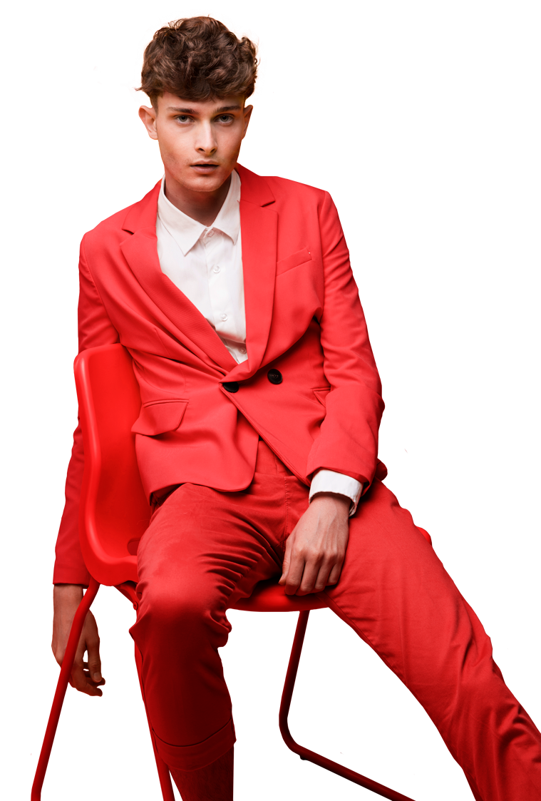
A VISUAL
UI DISPLAY
OF CURIO

Slide 28
VISITOR

Slide 29
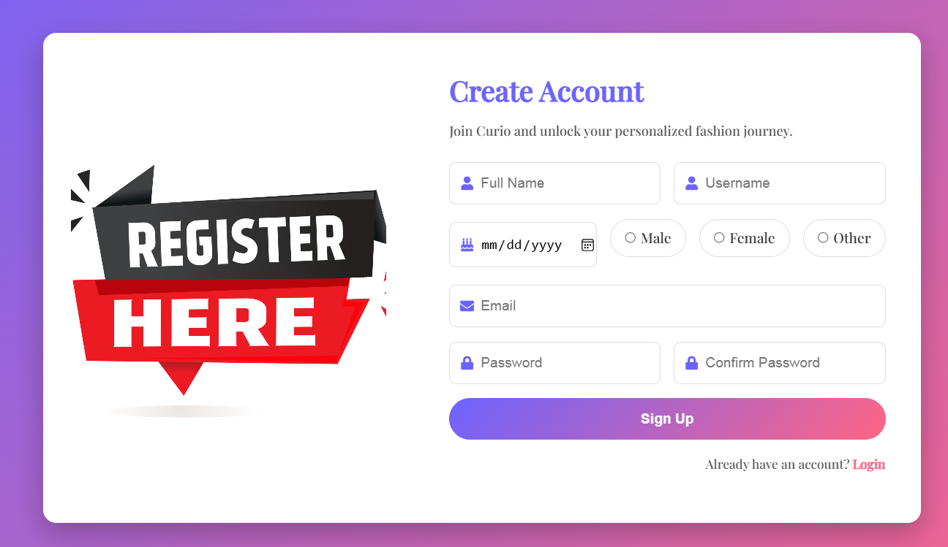

Slide 30
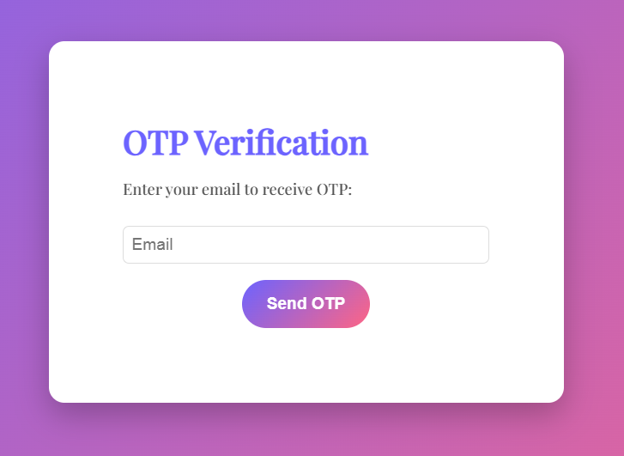

Slide 31
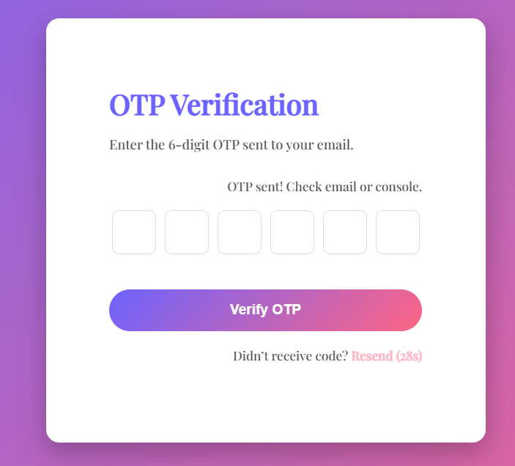

Slide 32
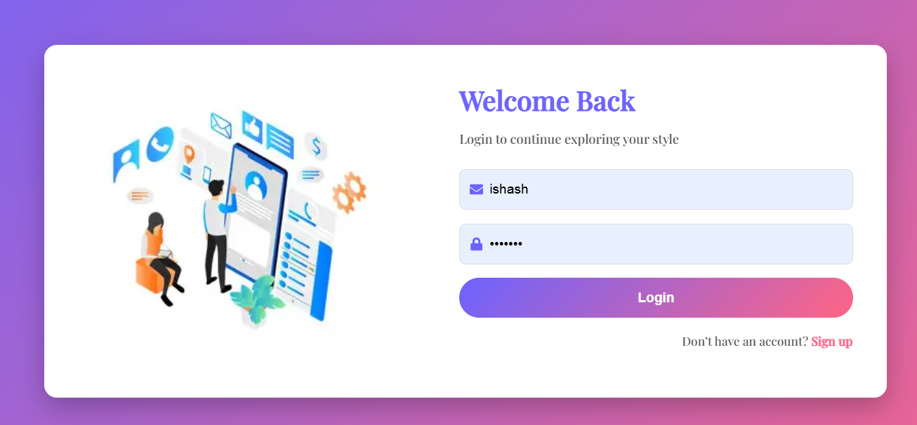

Slide 33
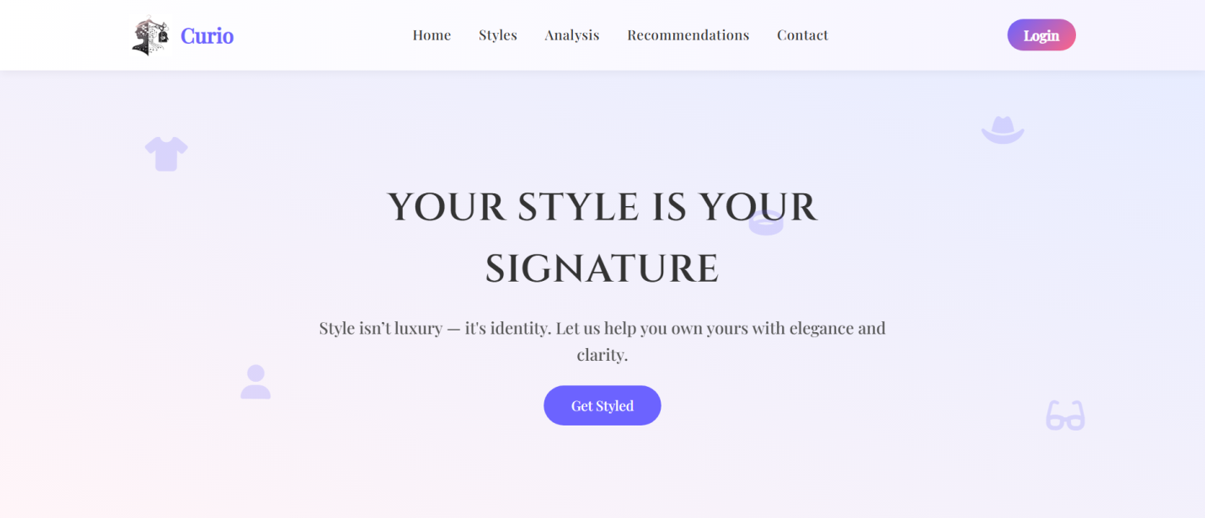

Slide 34
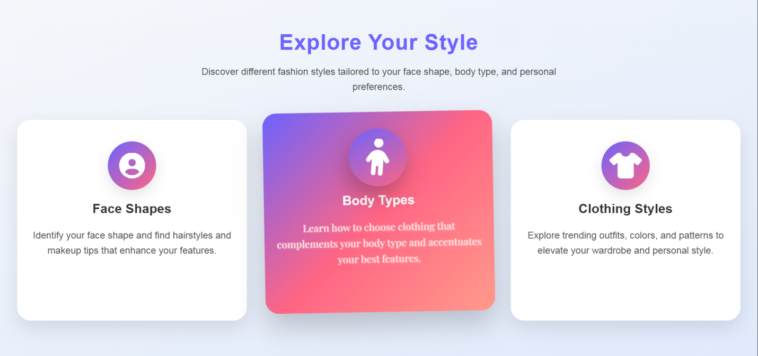

Slide 35
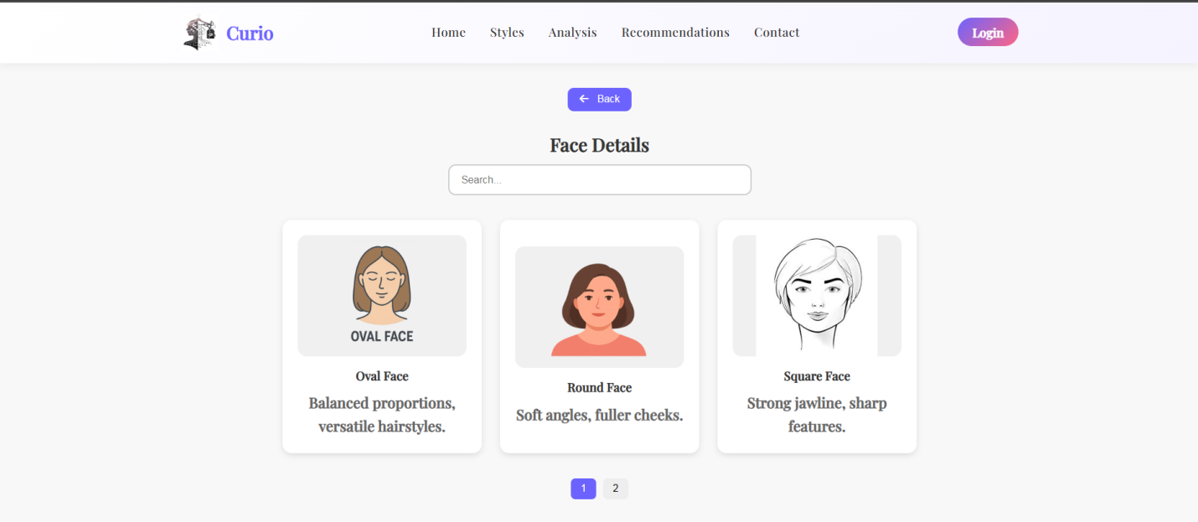

Slide 36
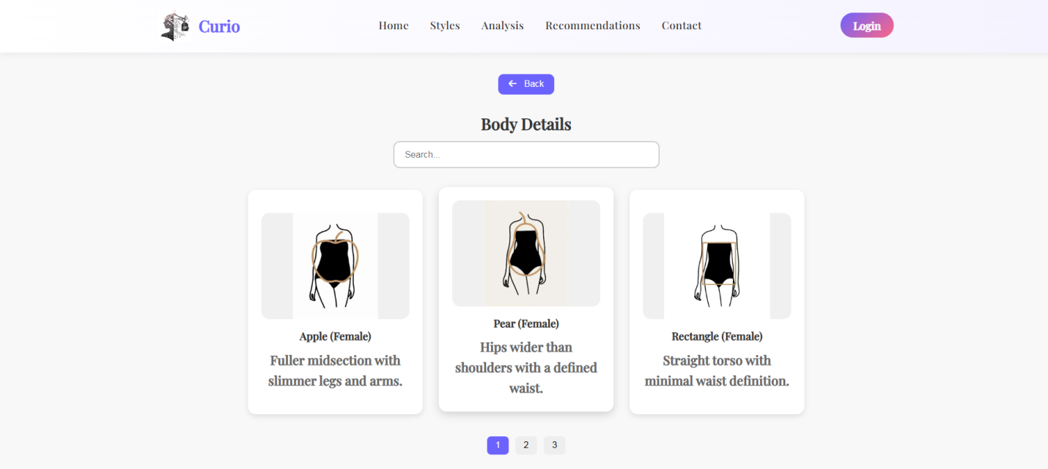

Slide 37
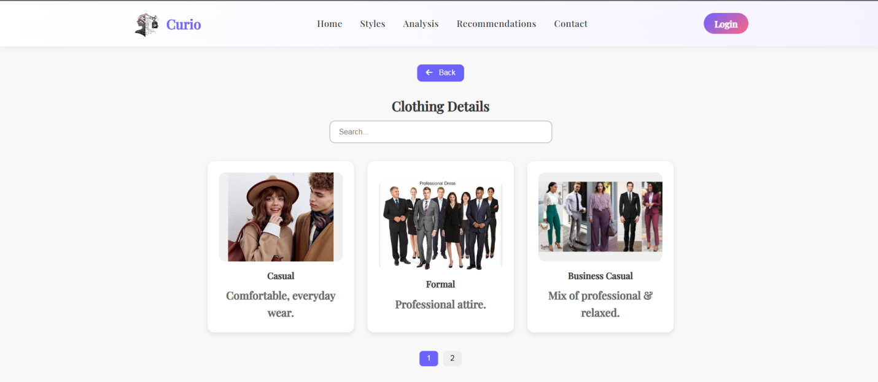

Slide 38
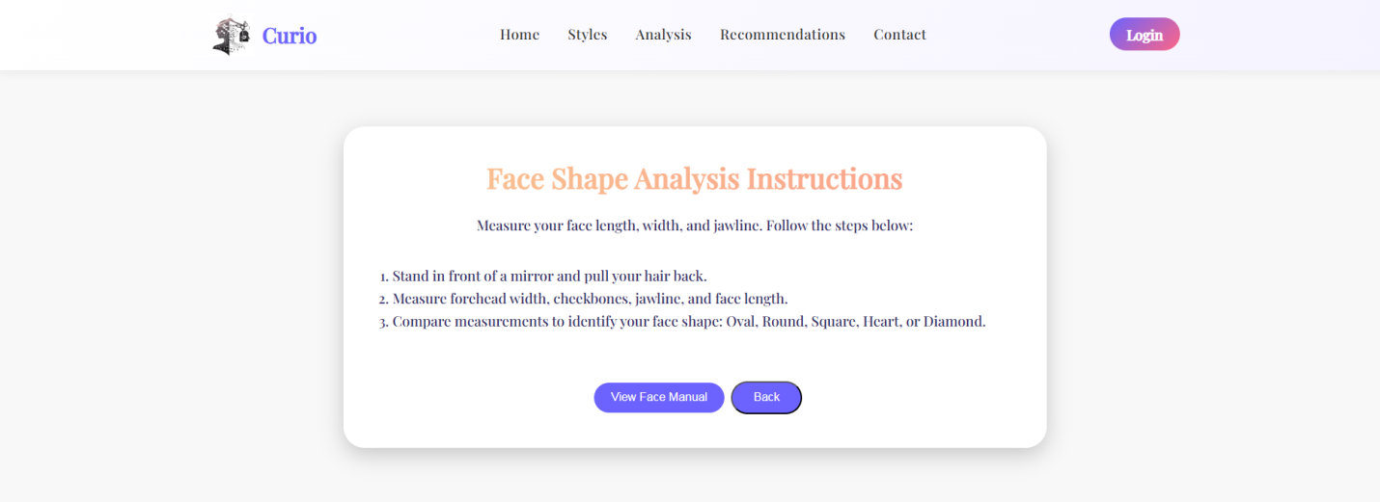

Slide 39
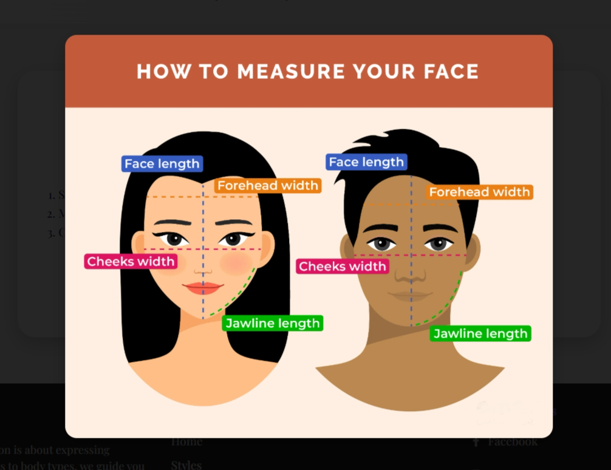

Slide 40
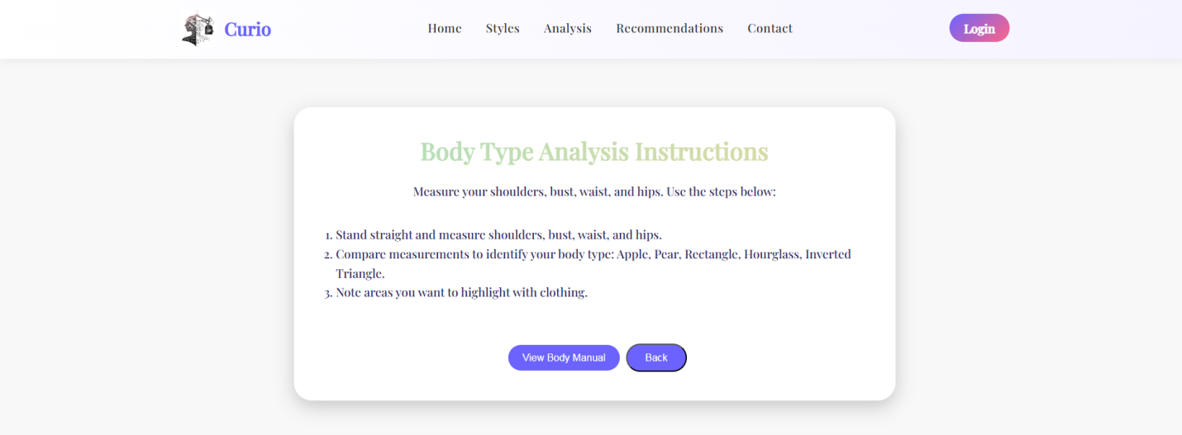

Slide 41
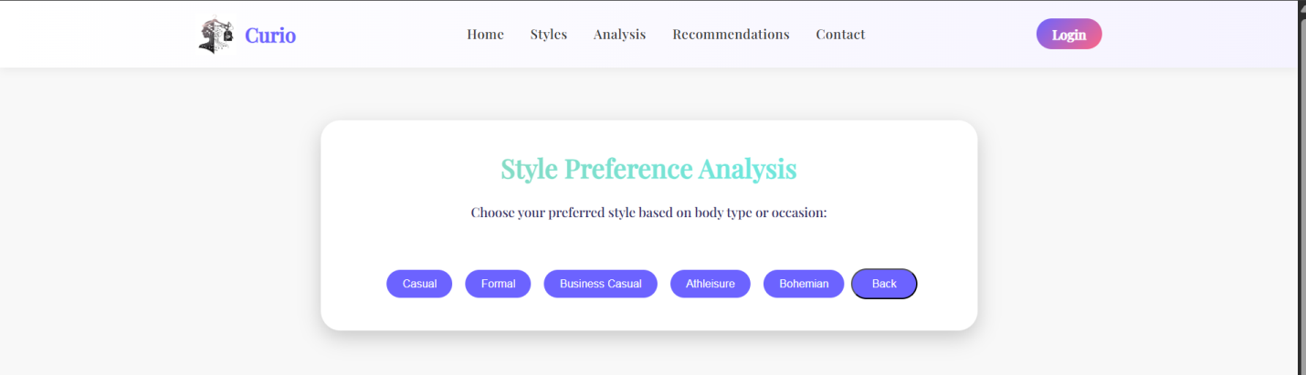

Slide 42
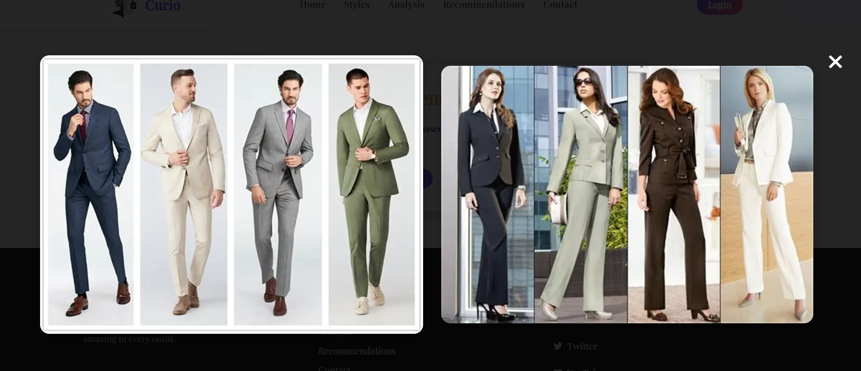

Slide 43
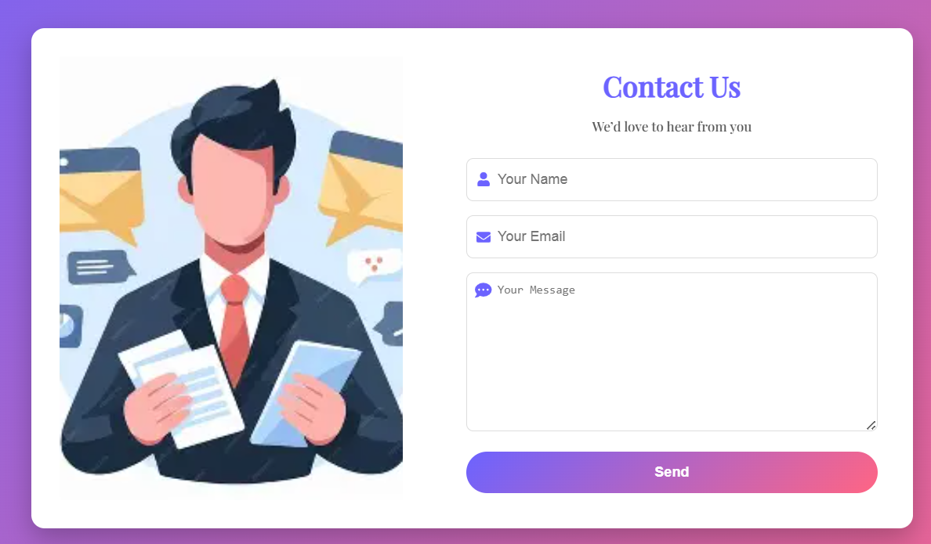

Slide 44
USERS

Slide 45
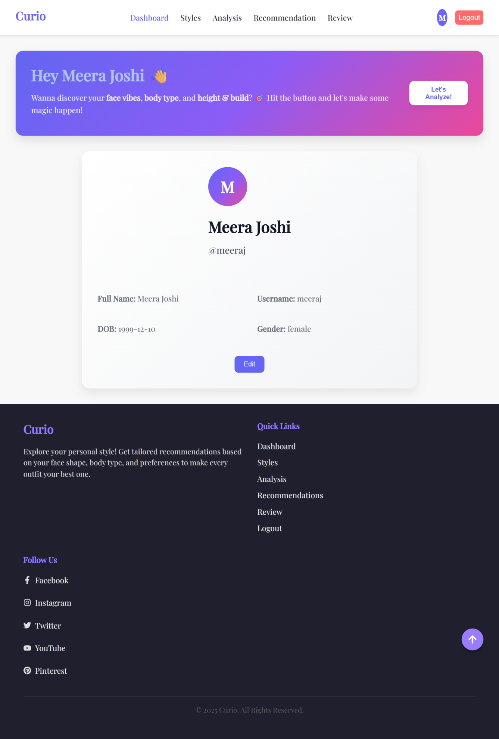

Slide 46
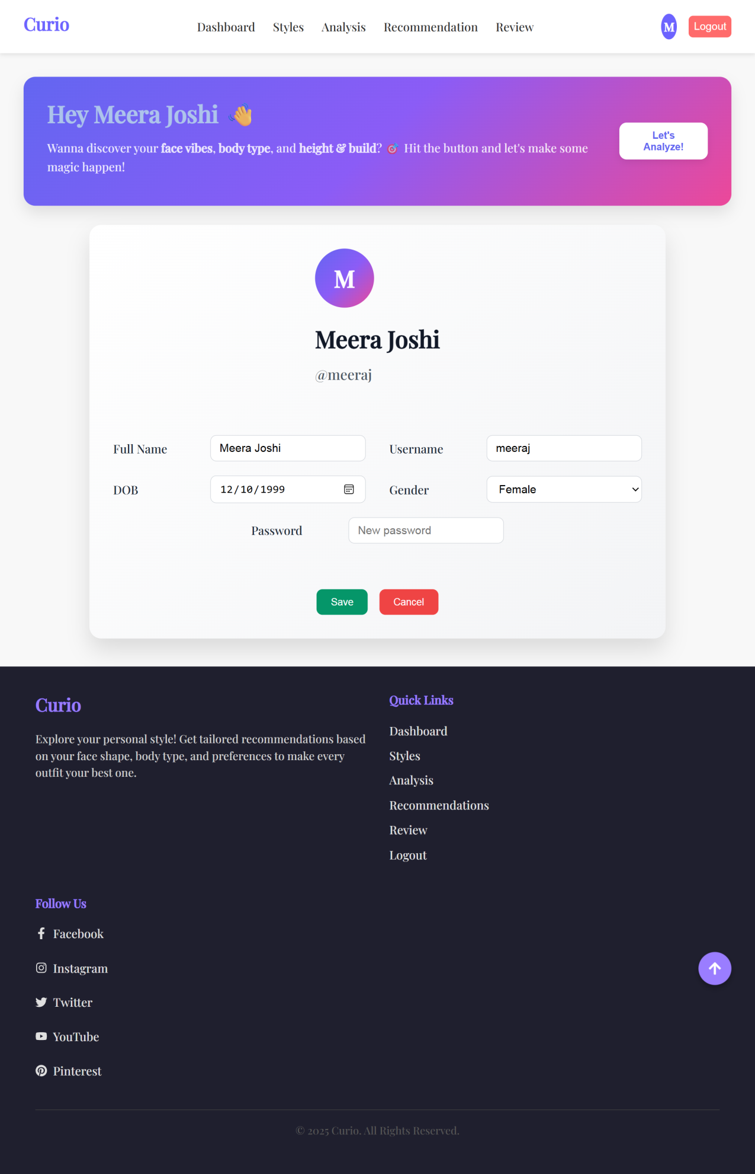

Slide 47
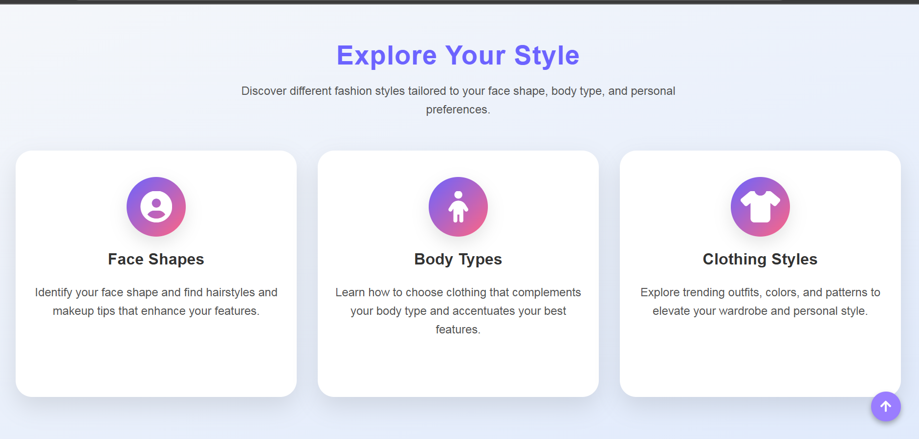

Slide 48
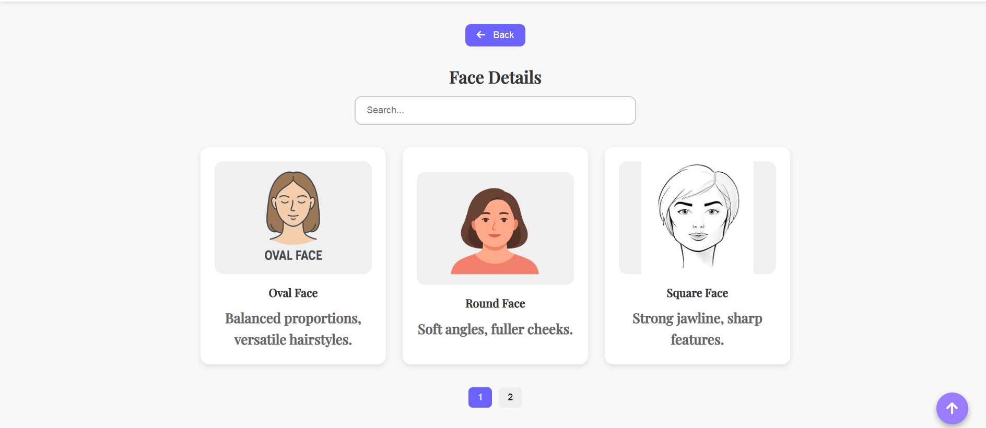

Slide 49
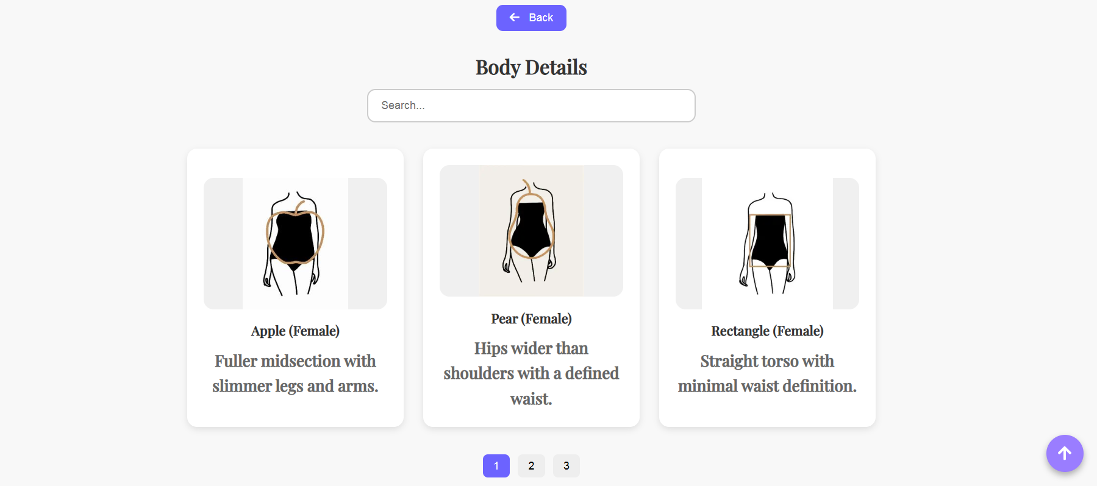

Slide 50
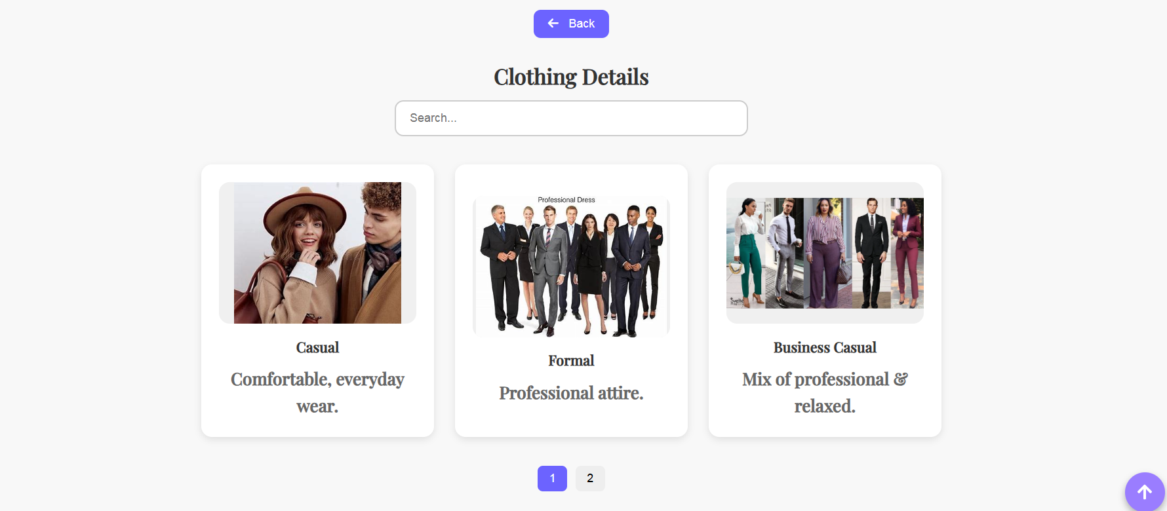

Slide 51
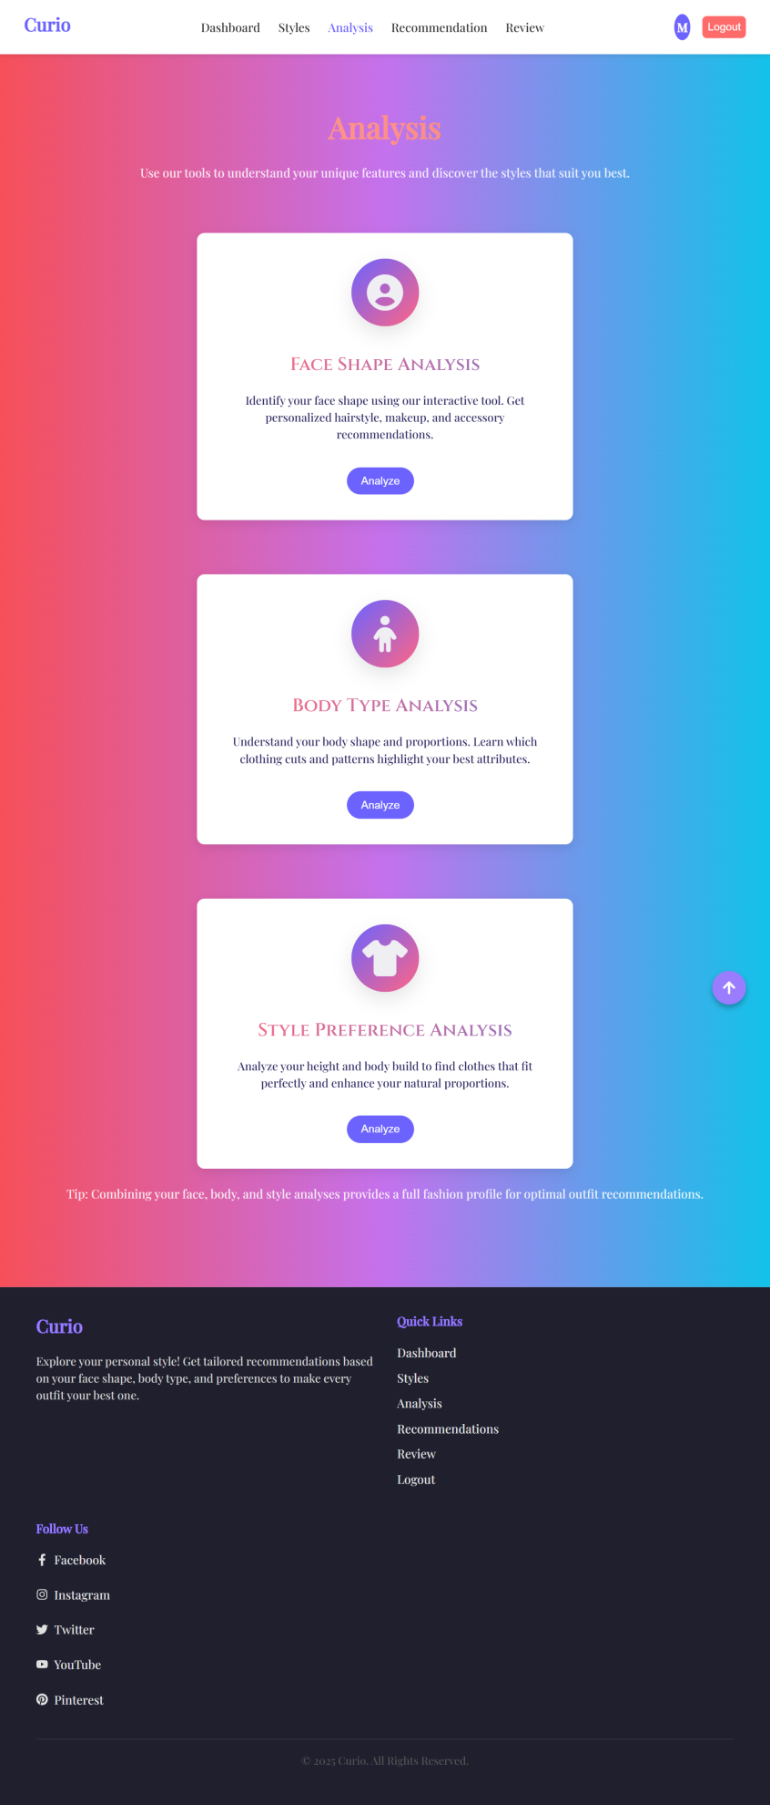

Slide 52
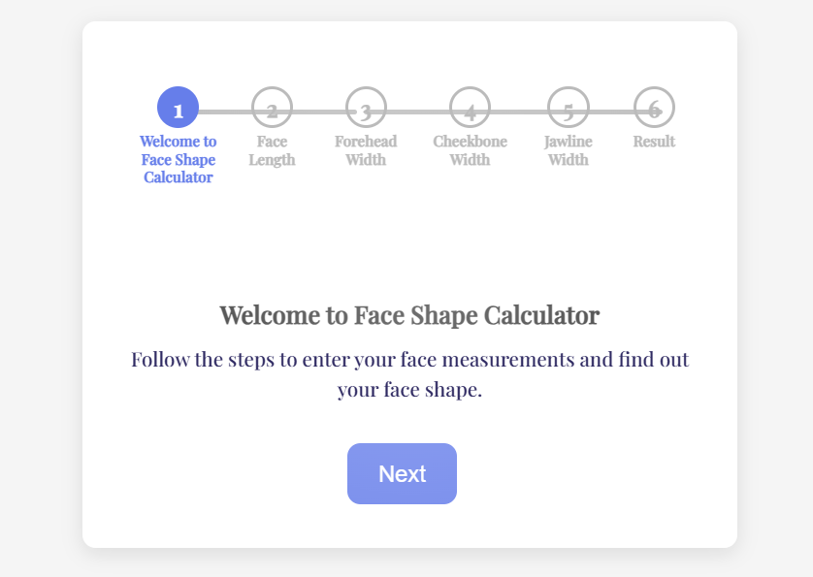

Slide 53
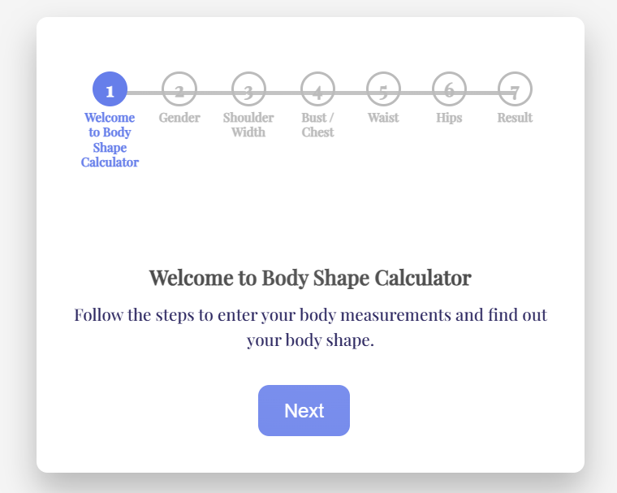

Slide 54
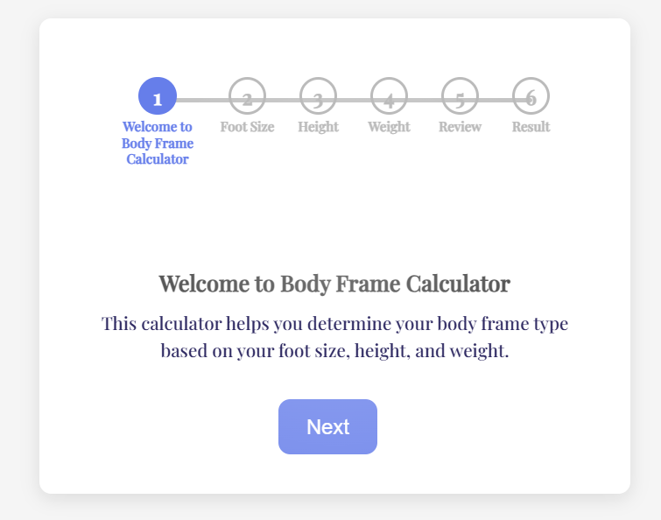

Slide 55
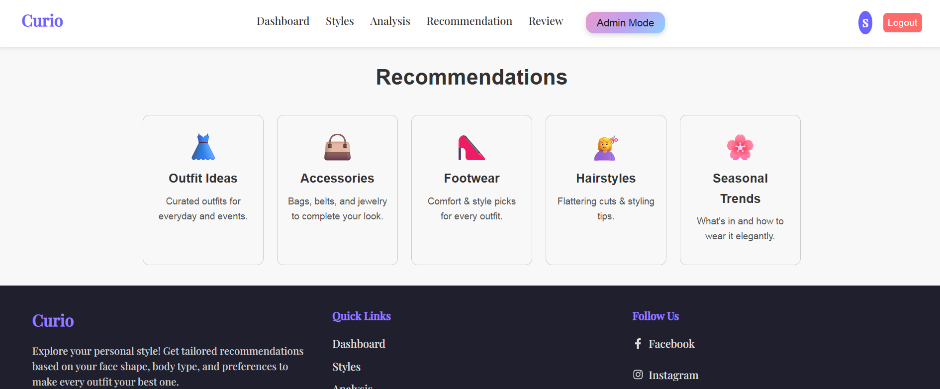

Slide 56
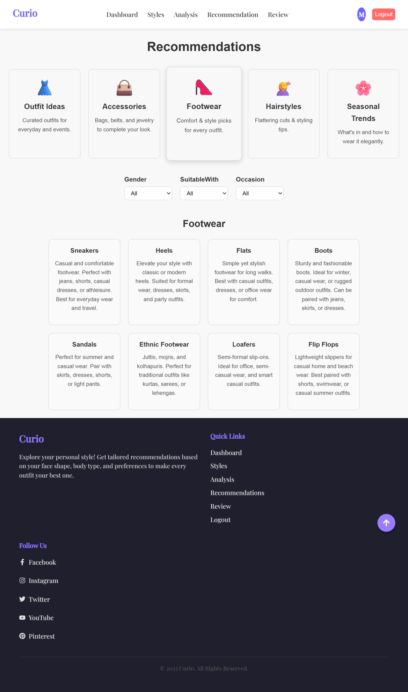

Slide 57
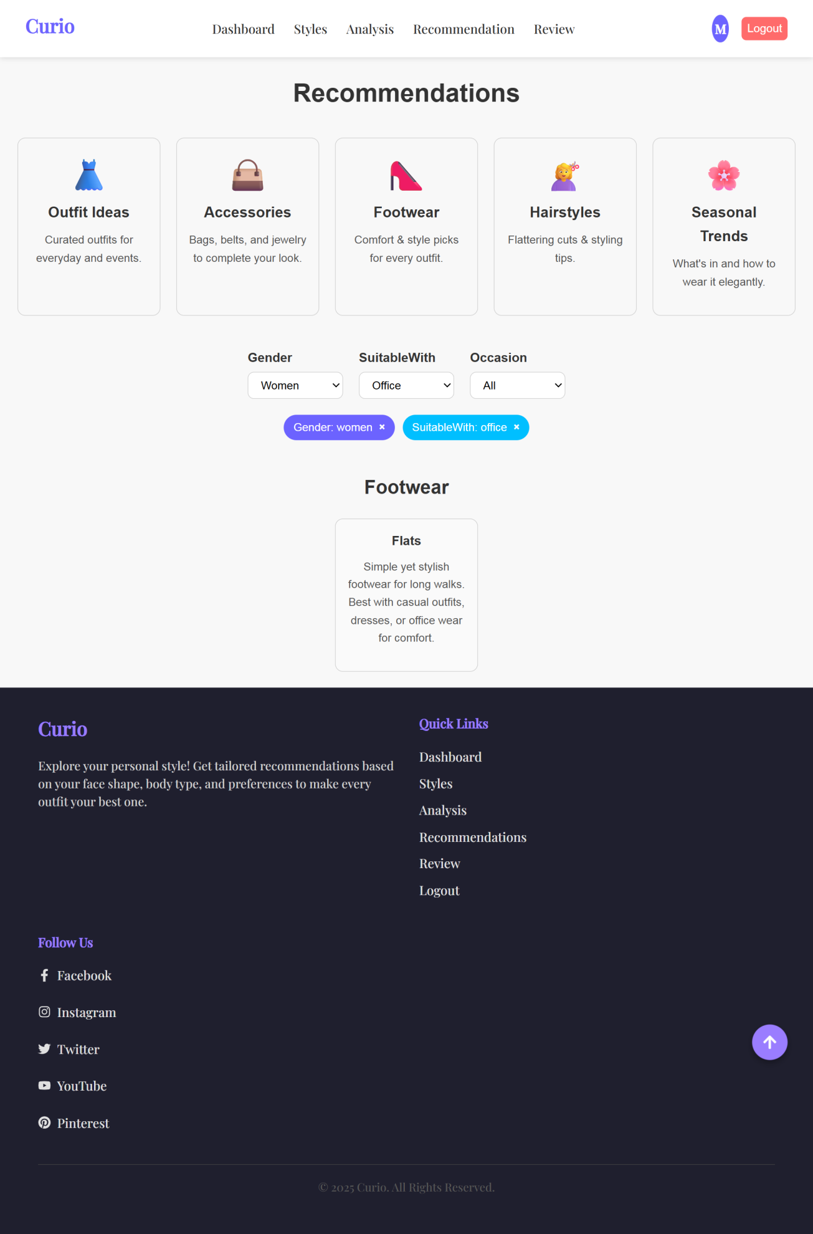

Slide 58
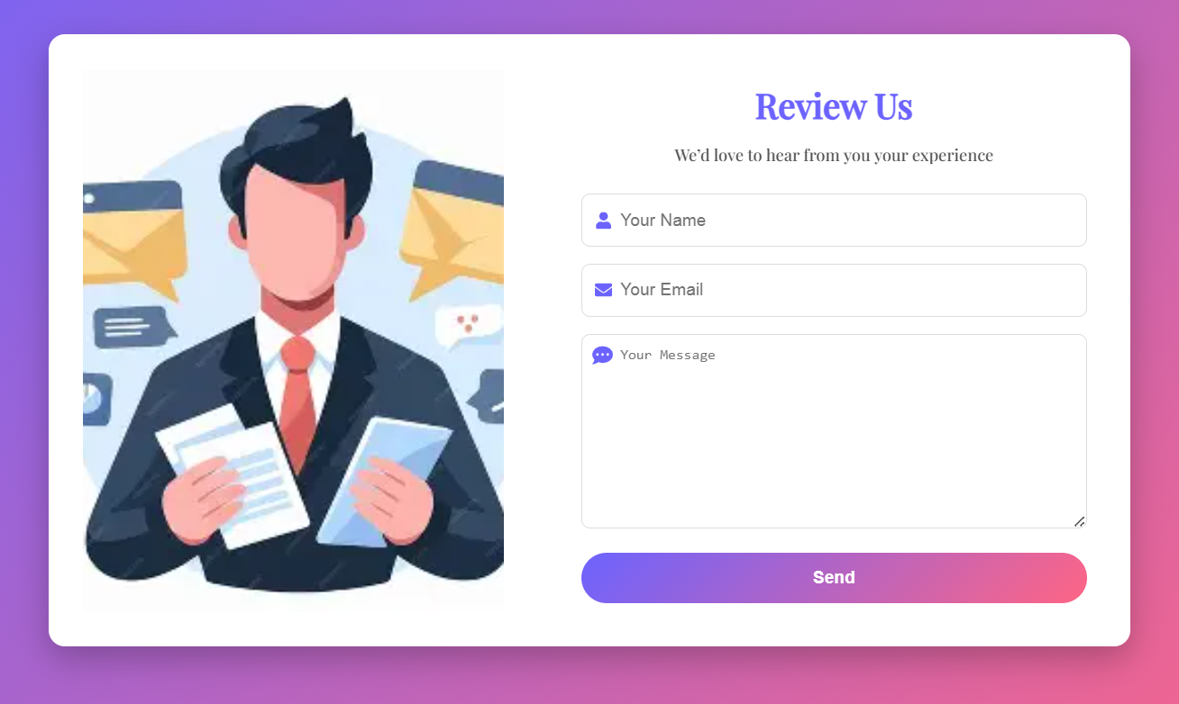

Slide 59
ADMIN

Slide 60
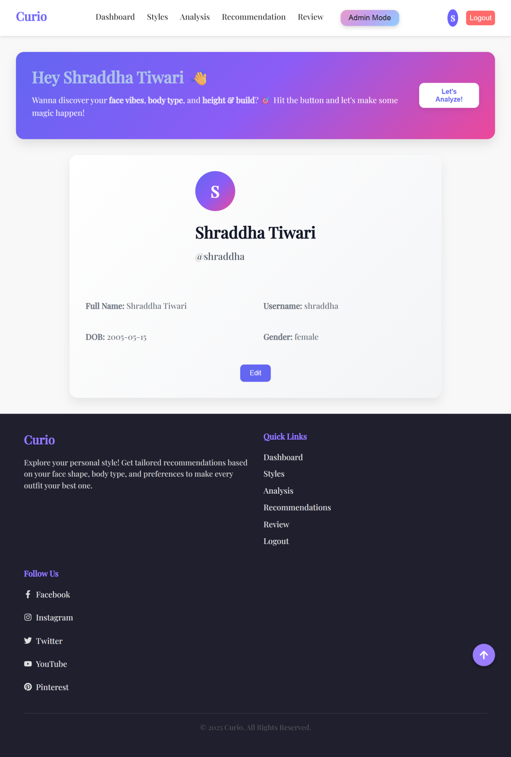

Slide 61
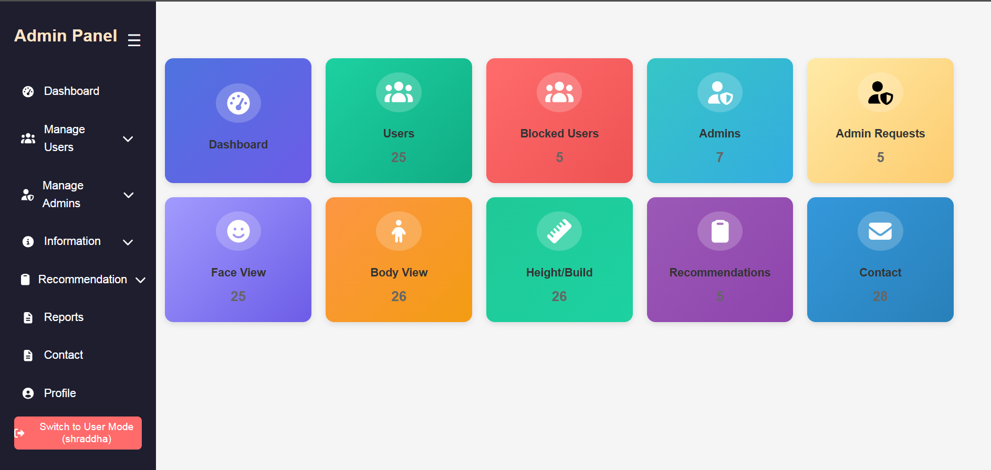

Slide 62
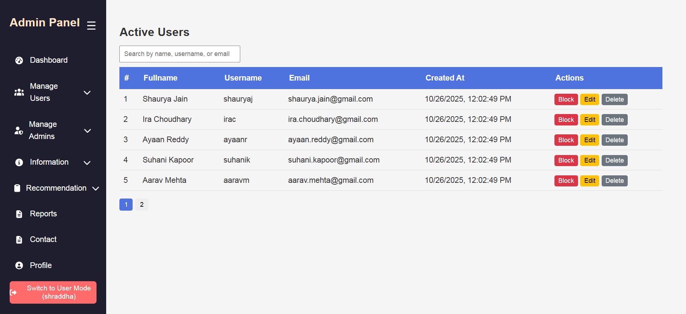

Slide 63
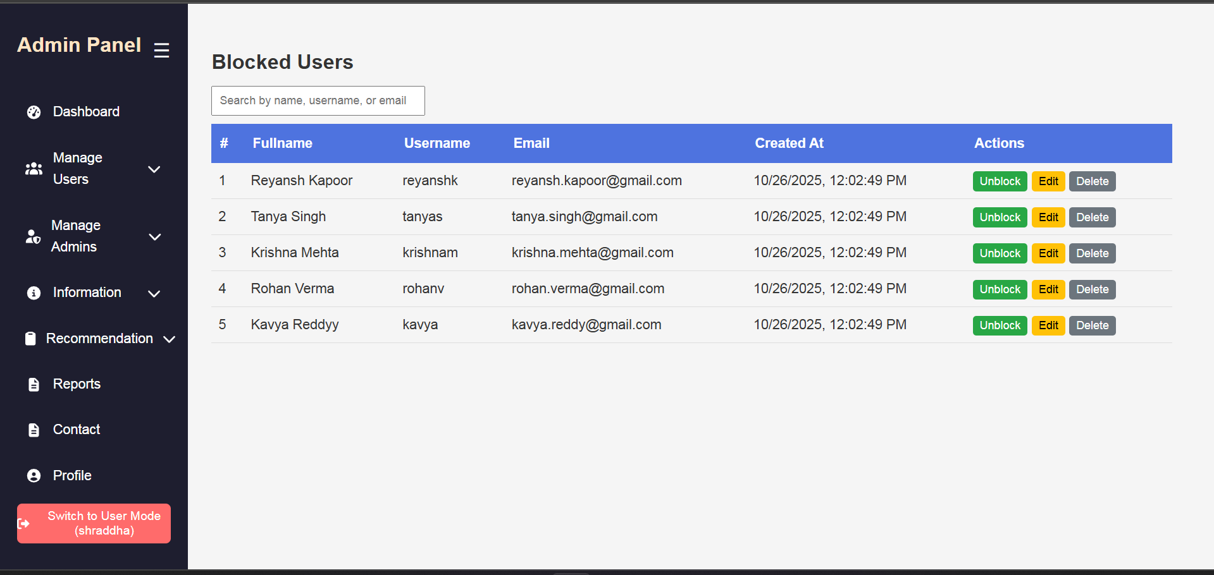

Slide 64
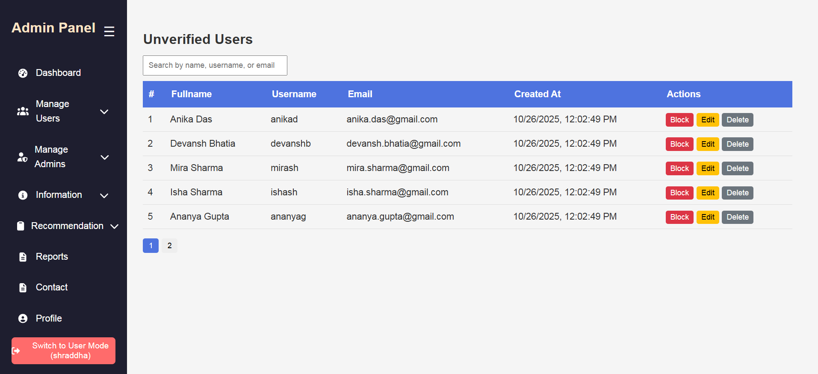

Slide 65
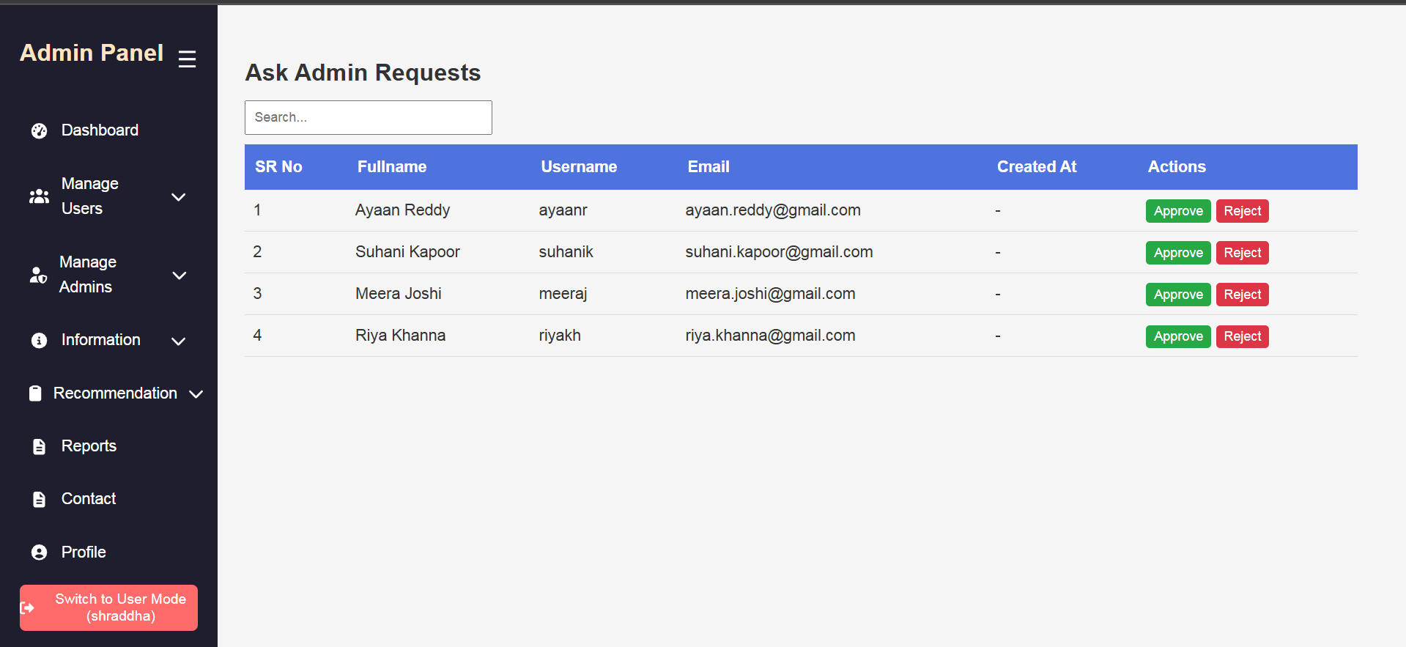

Slide 66
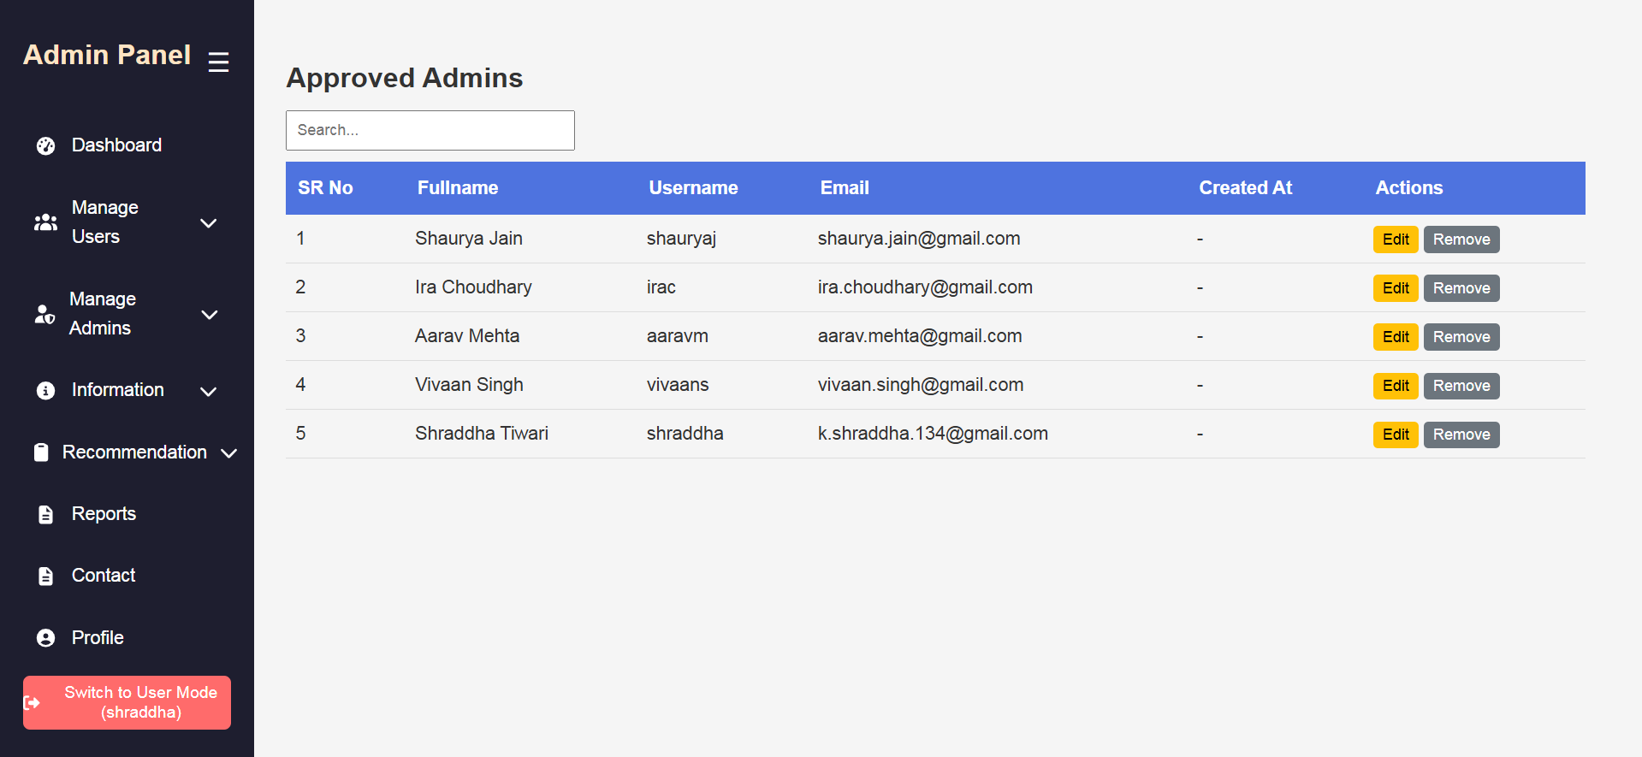

Slide 67
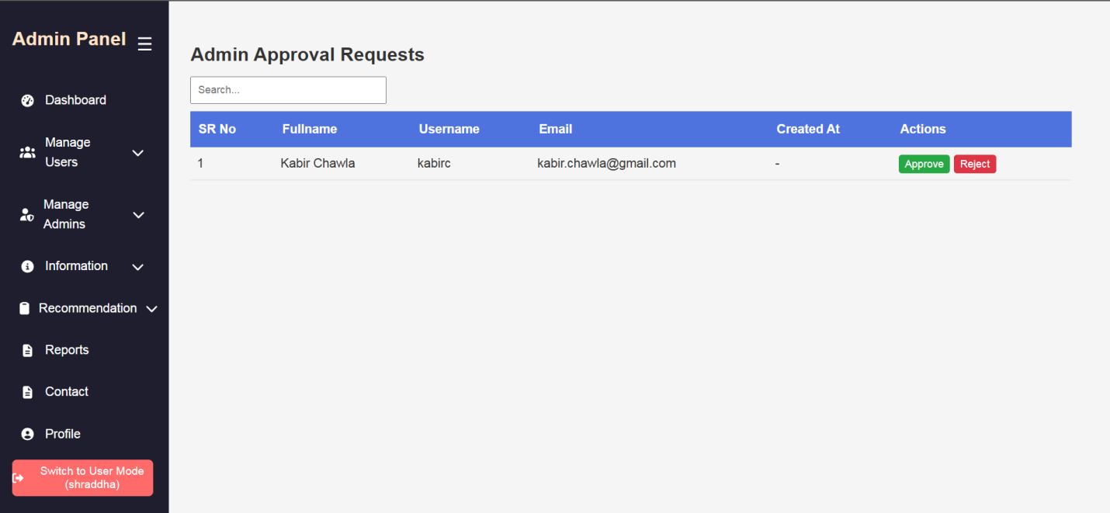

Slide 68
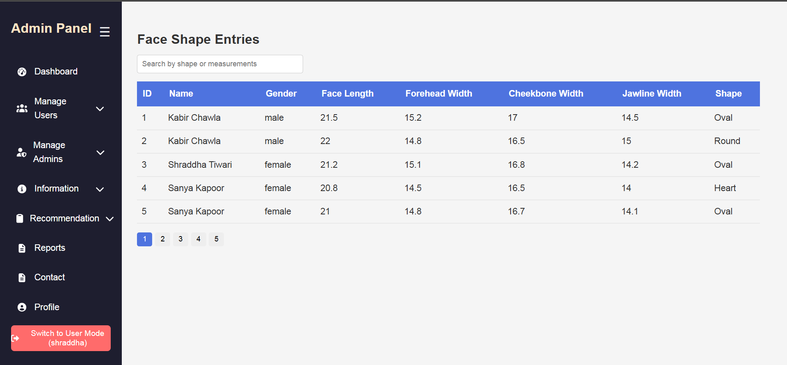

Slide 69


Slide 70


Slide 71


Slide 72


Slide 73


Slide 74


Slide 75

THANKS
Do you have any questions?
admin@curio.com I +91 908 192 9527
curio.com

